Slide 1
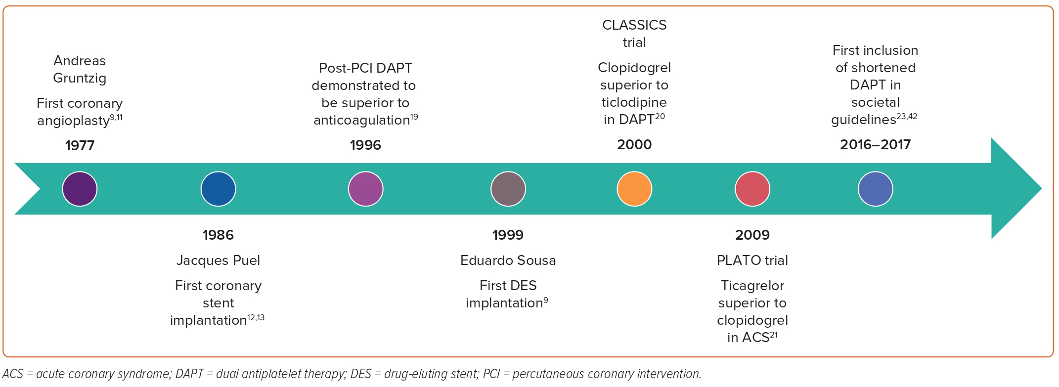
Tang KS, Banerjee S, Tang G, Patel PM, Frangieh AH
Figure 1: Timeline of Advances in Percutaneous Coronary Intervention and Dual Antiplatelet Therapy
Citation: Interventional Cardiology 2023;18:e31.
https://doi.org/10.15420/icr.2023.19

