Slide 1
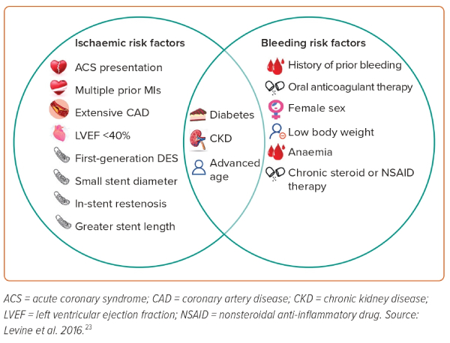
Tang KS, Banerjee S, Tang G, Patel PM, Frangieh AH
Figure 2: Factors Associated with Increased Risk of Stent Thrombosis/ischaemic Events or Increased Risk of Bleeding
Citation: Interventional Cardiology 2023;18:e31.
https://doi.org/10.15420/icr.2023.19

