Slide 1
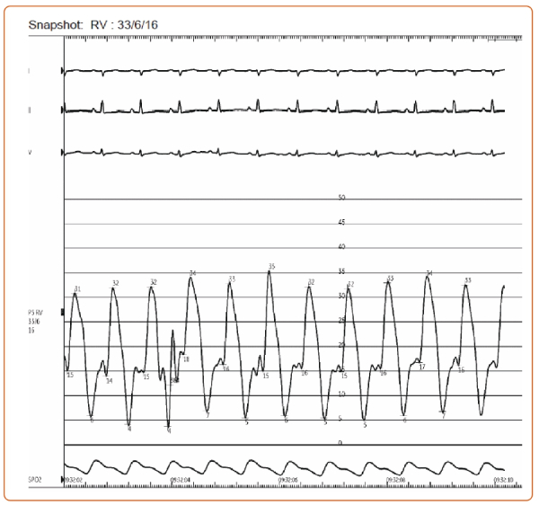
Pietrolungo C, Monzer N, Asturias K, Prenner S
Figure 2: Right Ventricular Pressure Tracing
Citation: US Cardiology Review 2023;17(Suppl 1):A3.
https://doi.org/10.15420/usc.2023.17.s1

