Slide 1
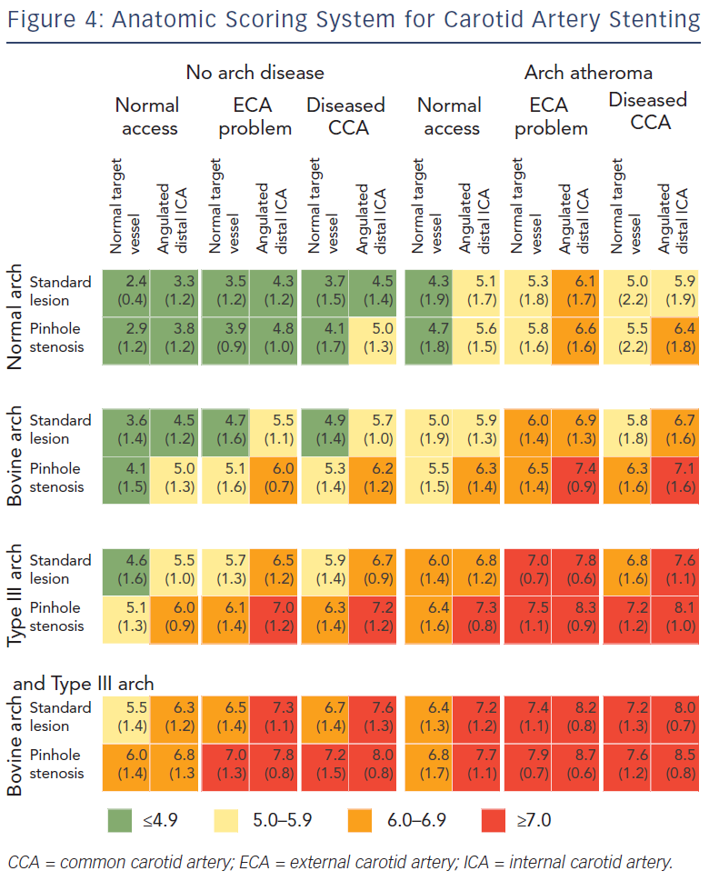
Willaert WI, Herzeele IV
Anatomic Scoring System For Carotid Artery Stenting
Citation: Interventional Cardiology Review 2013;8(1):50–6
https://doi.org/10.15420/icr.2013.8.1.50

