Slide 1
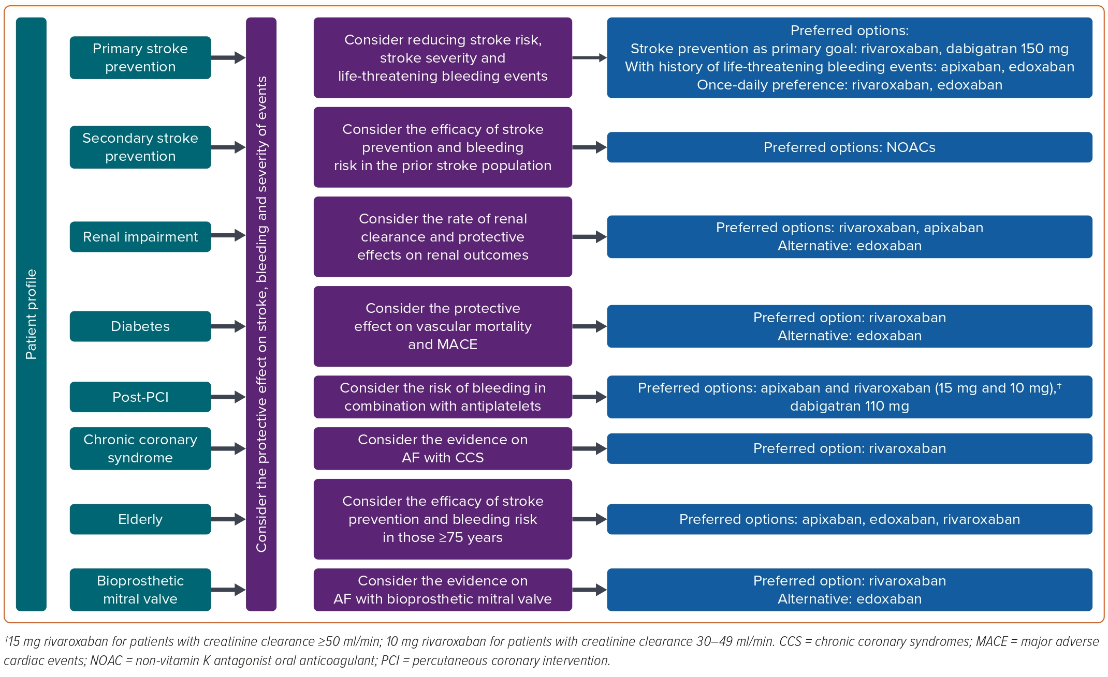
Ton MT, Ho THQ, Nguyen VL, Pham HM, Hoang SV, Vo NT, Thai NQ, Pham LT, Mai TD, Nguyen TH
Figure 3: Recommendations for Choice of Anticoagulant in Patients with AF
Citation: European Cardiology Review 2023;18:e62.
https://doi.org/10.15420/ecr.2023.25

