Slide 1
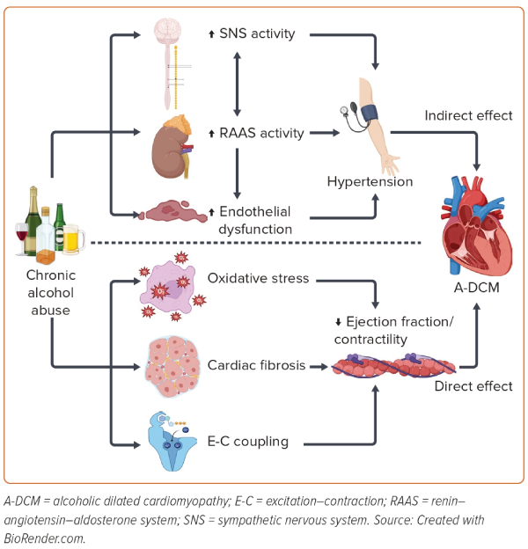
Rasoul D, Ajay A, Abdullah A, Mathew J, Lee Wei En B, Mashida K, Sankaranarayanan R
Figure 1: Direct and Indirect Mechanism of Non-ischaemic Dilated Alcoholic Cardiomyopathy
Citation: European Cardiology Review 2023;18:e65.
https://doi.org/10.15420/ecr.2023.12

