Slide 1
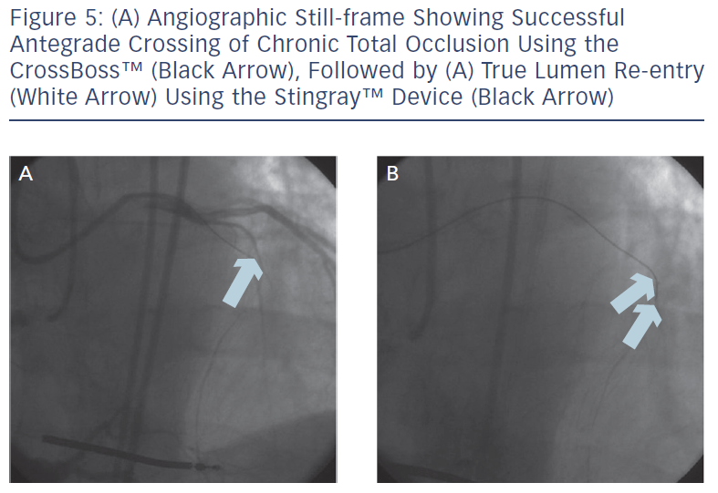
Ramanath VS, Thompson C
Figure 5: (A) Angiographic Still-frame Showing Successful Antegrade Crossing of Chronic Total Occlusion Using the CrossBossTM (Black Arrow), Followed by (A) True Lumen Re-entry (White Arrow) Using the StingrayTM Device (Black Arrow)
Citation: Interventional Cardiology Review 2013;8(1):41–5
https://doi.org/10.15420/icr.2013.8.1.41

