Slide 1
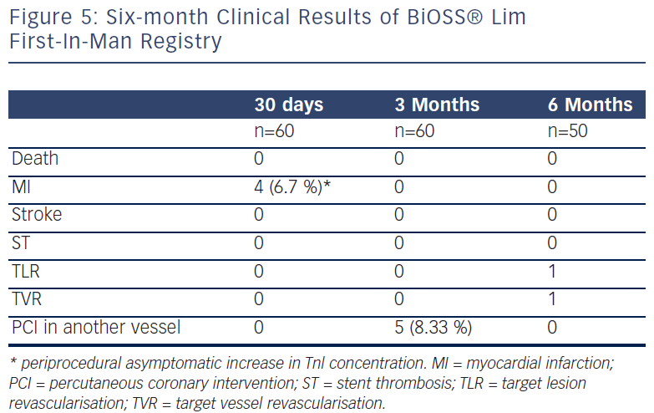
Gil R, Vassilev D, Bil J
Six-Month Clinical Results Of BiOSS® Lim First-In-Man Registry
Citation: Interventional Cardiology Review 2013;8(1):19–22
https://doi.org/10.15420/icr.2013.8.1.19

