Slide 1
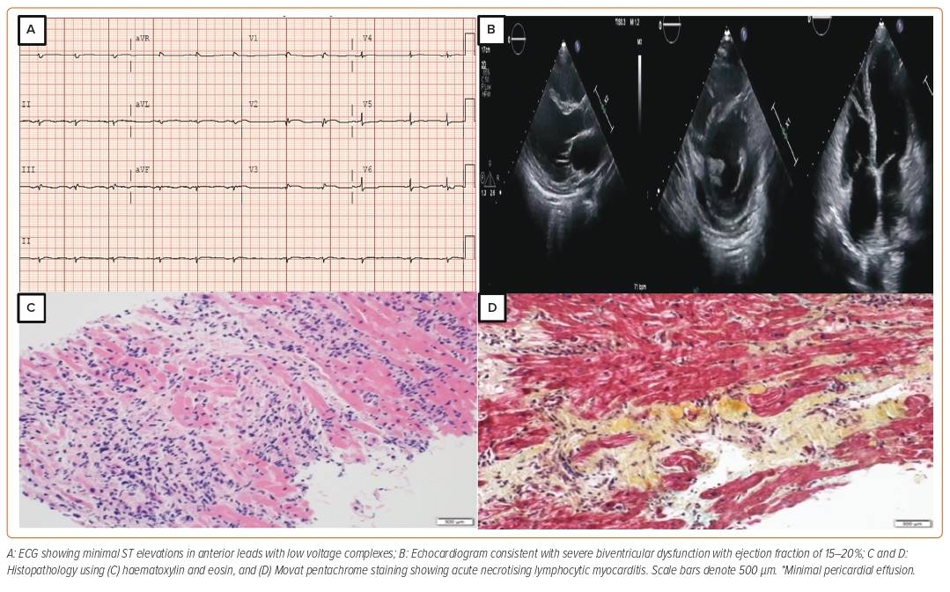
Hashmani S, Manla Y, Al Matrooshi N, Bader F
Figure 1: Electrocardiogram, Echocardiogram and Biopsy Findings in Our Case
Citation: Cardiac Failure Review 2024;10:e02.
https://doi.org/10.15420/cfr.2023.02

