Slide 1
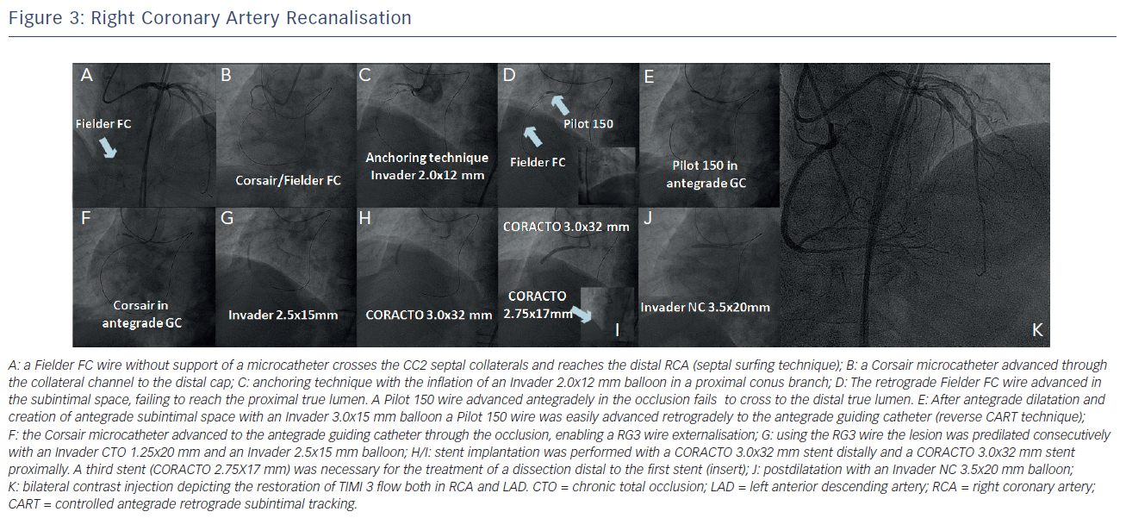
Konstantinidis N, Sianos G
Right Coronary Artery Recanalisation
Citation: Interventional Cardiology Review 2013;8(1):46–9
https://doi.org/10.15420/icr.2013.8.1.46

