Slide 1
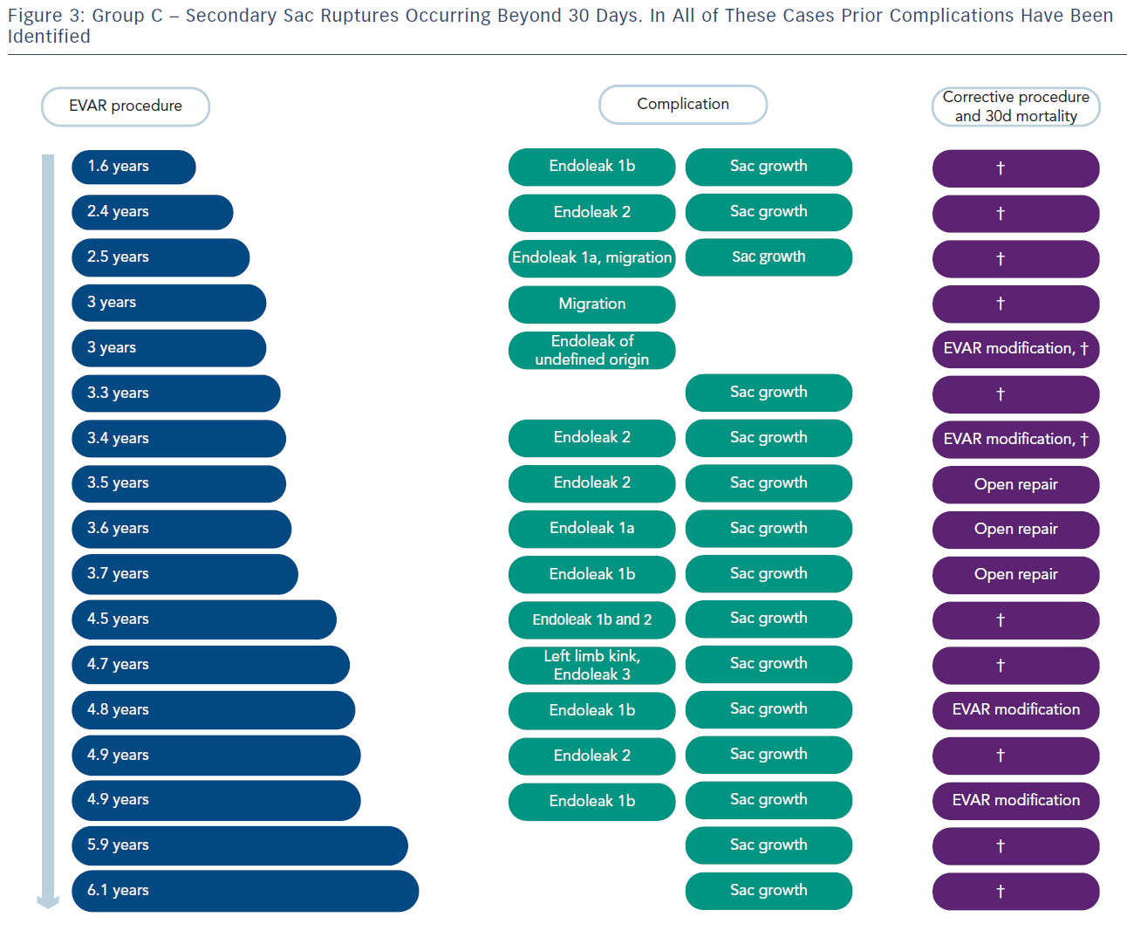
von Allmen RS, Dick F, Wyss TR, Greenhalgh RM
Group C – Secondary Sac Ruptures
Citation: Interventional Cardiology Review 2013;8(1):57–60
https://doi.org/10.15420/icr.2013.8.1.57

