Slide 1
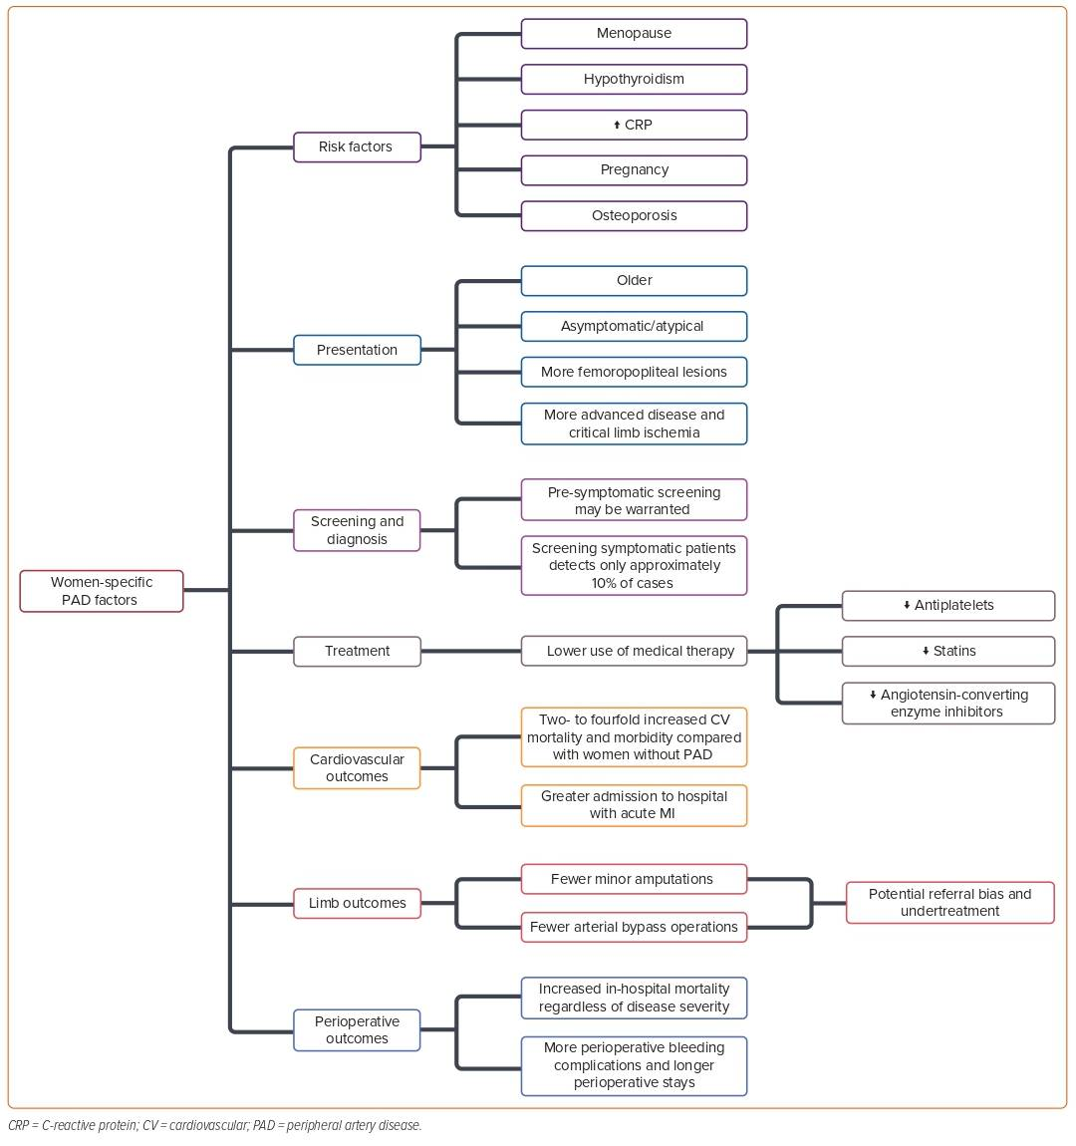
Martinez A, Huang J, Harzand A
Figure 1: Summary of Peripheral Artery Disease Risk Factors, Screening, Presentation, Treatment, and Outcomes Specific to Women
Citation: US Cardiology Review 2024;18:e04
https://doi.org/10.15420/usc.2022.28

