Slide 1
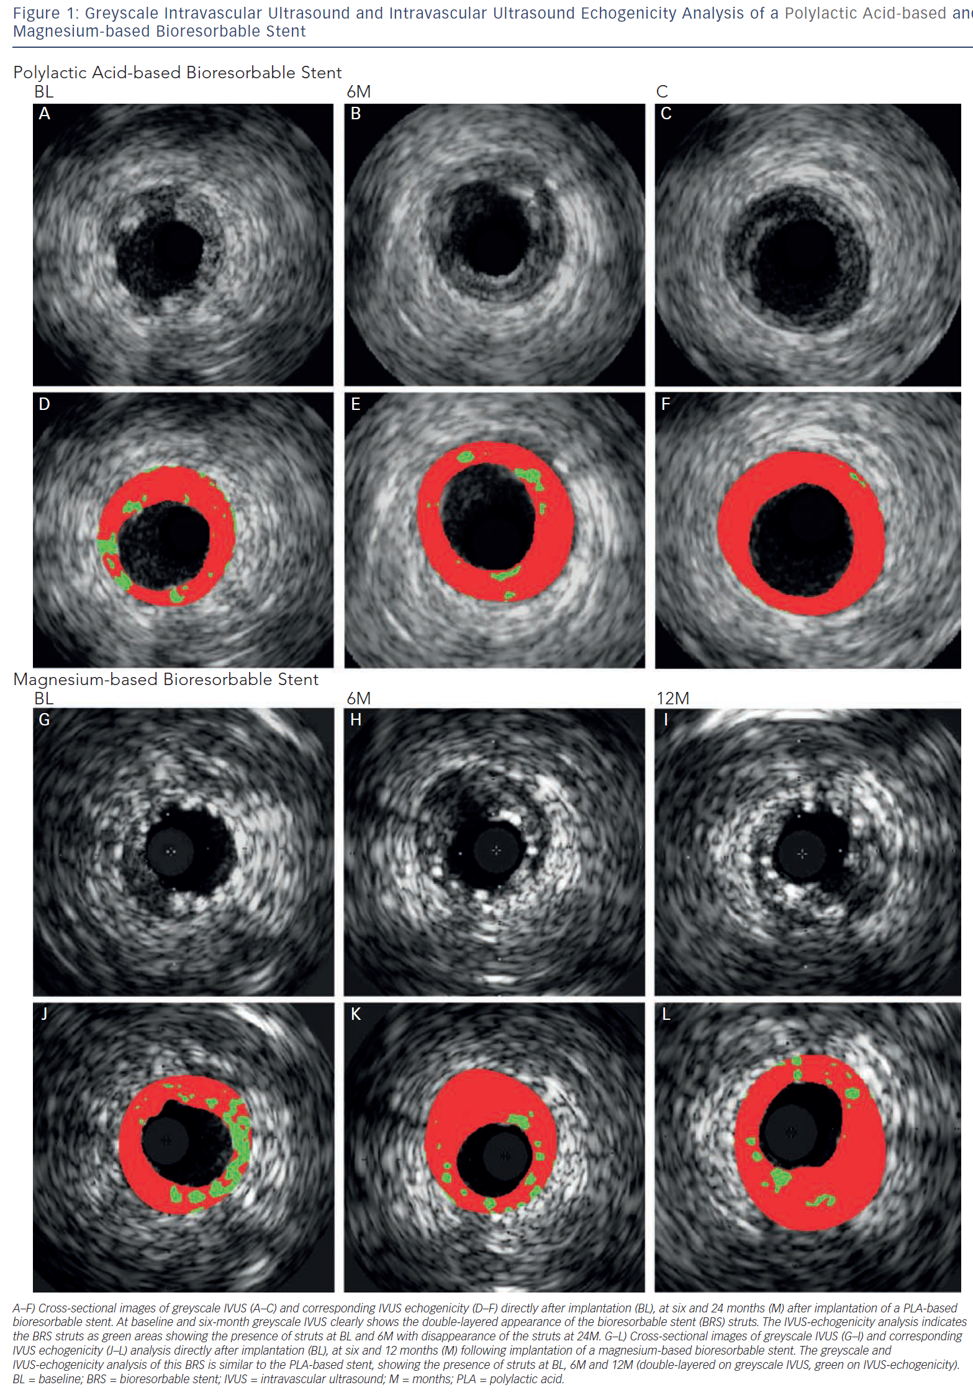
van Ditzhuijzen NS, Ligthart JM, Bruining N, Regar E, van Beusekom HM
Greyscale Intravascular Ultrasound And Intravascular Ultrasound Echogenicity
Citation: Interventional Cardiology Review 2013;8(1):23–35
https://doi.org/10.15420/icr.2013.8.1.23

