Slide 1
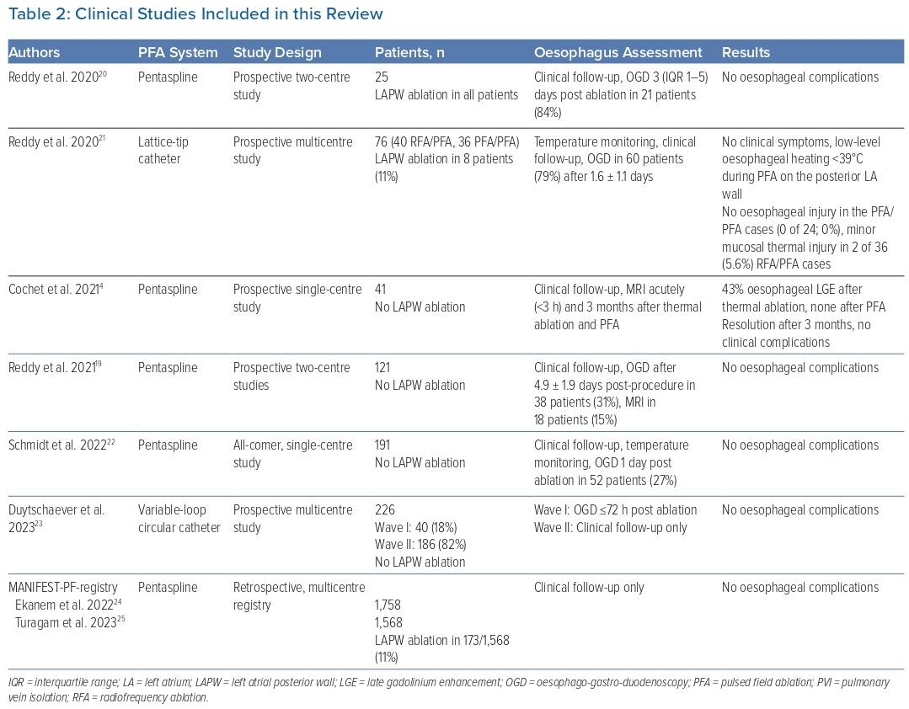
Nies M, Watanabe K, Kawamura I, Koruth JS
Clinical Studies Included in this Review
Citation: Arrhythmia & Electrophysiology Review 2024;13:e02
https://doi.org/10.15420/aer.2023.16

