Slide 1

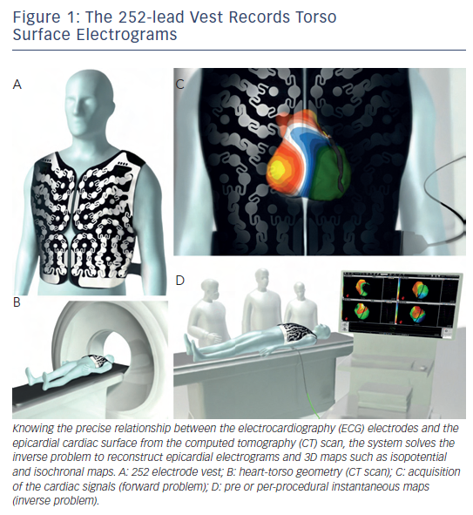
Shah AJ, Hocini M, Pascale P, Roten L, Komatsu Y, Daly M, Ramoul K, Denis A, Derval N, Sacher F, Dubois R, Bokan R, Eliatou S, Strom M, Ramanathan C, Jaïs P, Ritter P, Haissaguerre M
Figure 1: The 252-lead Vest Records TorsoSurface Electrograms
Citation: Arrhythmia & Electrophysiology Review 2013;2(1):16-22
https://doi.org/10.15420/aer.2013.2.1.16

