Slide 1
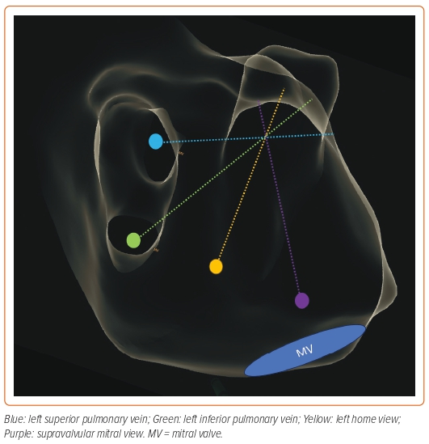
Diaz JC, Duque M, Marin J, Aristizabal J, Niño C, Bastidas O, Matos CD, Hoyos C, Hincapie D, Romero JE
Figure 4: Representation of the Location of the Intracardiac Echocardiography Catheter within the LA to Obtain Different Views
Citation: Arrhythmia & Electrophysiology Review 2024;13:e03.
https://doi.org/10.15420/aer.2023.29

