Slide 1
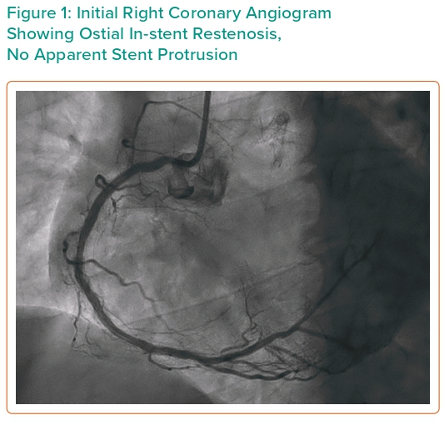
Damarkusuma A, Mota P, Patel B, Oommen M
Figure 1: Initial Right Coronary Angiogram Showing Ostial In-stent Restenosis, No Apparent Stent Protrusion
Citation: Interventional Cardiology 2024;19:e04.
https://doi.org/10.15420/icr.2023.34

