Slide 1
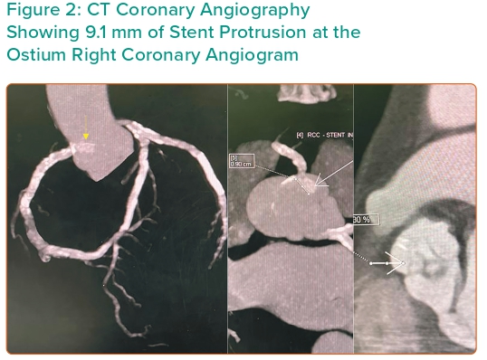
Damarkusuma A, Mota P, Patel B, Oommen M
Figure 2: CT Coronary Angiography Showing 9.1 mm of Stent Protrusion at the Ostium Right Coronary Angiogram
Citation: Interventional Cardiology 2024;19:e04.
https://doi.org/10.15420/icr.2023.34

