Slide 1
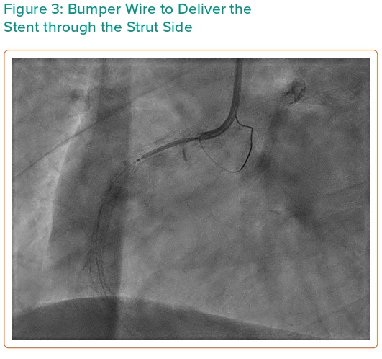
Damarkusuma A, Mota P, Patel B, Oommen M
Figure 3: Bumper Wire to Deliver the Stent through the Strut Side
Citation: Interventional Cardiology 2024;19:e04.
https://doi.org/10.15420/icr.2023.34

