Slide 1
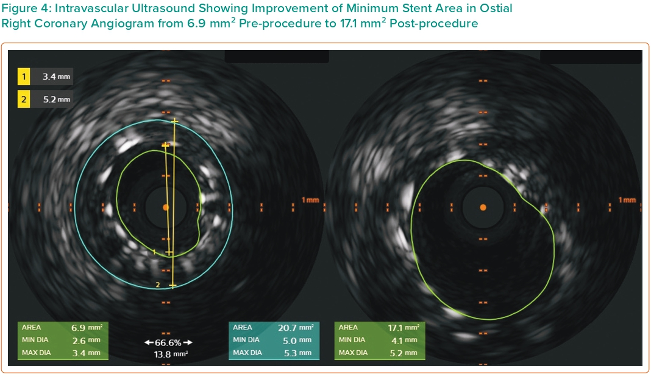
Damarkusuma A, Mota P, Patel B, Oommen M
Figure 4: Intravascular Ultrasound Showing Improvement of Minimum Stent Area in Ostial Right Coronary Angiogram from 6.9 mm2 Pre-procedure to 17.1 mm2 Post-procedure
Citation: Interventional Cardiology 2024;19:e04.
https://doi.org/10.15420/icr.2023.34

