Slide 1
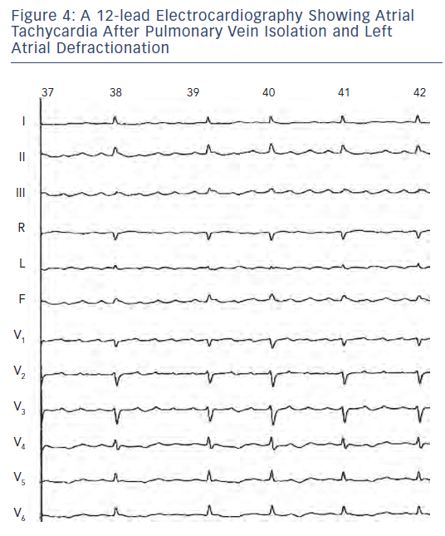
Shah AJ, Hocini M, Pascale P, Roten L, Komatsu Y, Daly M, Ramoul K, Denis A, Derval N, Sacher F, Dubois R, Bokan R, Eliatou S, Strom M, Ramanathan C, Jaïs P, Ritter P, Haissaguerre M
Figure 4: A 12-lead Electrocardiography Showing AtrialTachycardia After Pulmonary Vein Isolation and LeftAtrial Defractionation
Citation: Arrhythmia & Electrophysiology Review 2013;2(1):16-22
https://doi.org/10.15420/aer.2013.2.1.16

