Slide 1
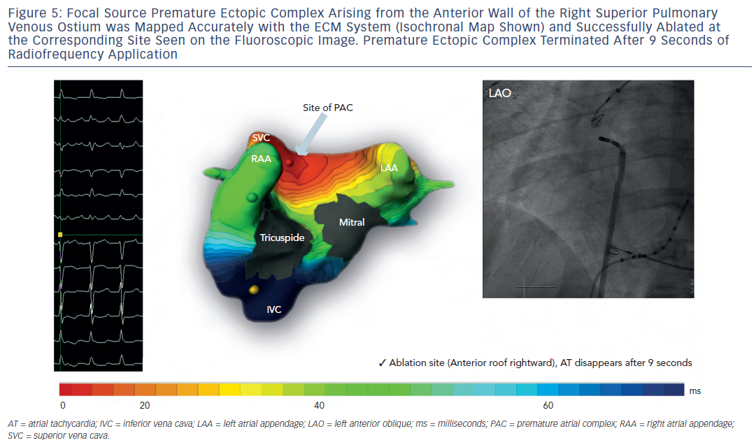
Shah AJ, Hocini M, Pascale P, Roten L, Komatsu Y, Daly M, Ramoul K, Denis A, Derval N, Sacher F, Dubois R, Bokan R, Eliatou S, Strom M, Ramanathan C, Jaïs P, Ritter P, Haissaguerre M
Figure 5: Focal Source Premature Ectopic Complex Arising from the Anterior Wall of the Right Superior PulmonaryVenous Ostium was Mapped Accurately with the ECM System (Isochronal Map Shown) and Successfully Ablated atthe Corresponding Site Seen on the Fluoroscopic Image. Premature Ectopic Complex Terminated After 9 Seconds ofRadiofrequency Application
Citation: Arrhythmia & Electrophysiology Review 2013;2(1):16-22
https://doi.org/10.15420/aer.2013.2.1.16

