Slide 1
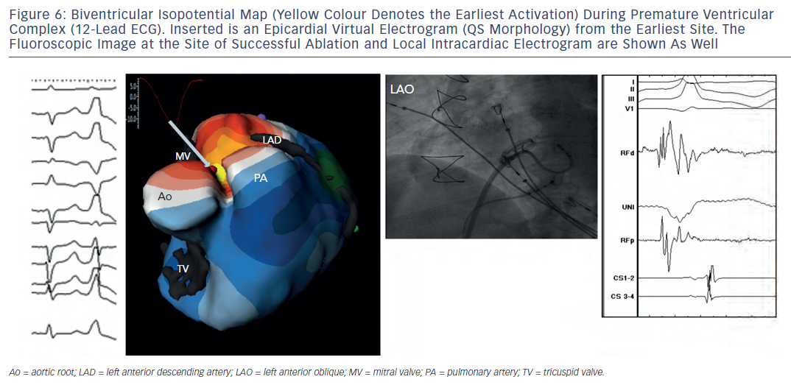
Shah AJ, Hocini M, Pascale P, Roten L, Komatsu Y, Daly M, Ramoul K, Denis A, Derval N, Sacher F, Dubois R, Bokan R, Eliatou S, Strom M, Ramanathan C, Jaïs P, Ritter P, Haissaguerre M
Figure 6: Biventricular Isopotential Map (Yellow Colour Denotes the Earliest Activation) During Premature VentricularComplex (12-Lead ECG). Inserted is an Epicardial Virtual Electrogram (QS Morphology) from the Earliest Site. TheFluoroscopic Image at the Site of Successful Ablation and Local Intracardiac Electrogram are Shown As Well
Citation: Arrhythmia & Electrophysiology Review 2013;2(1):16-22
https://doi.org/10.15420/aer.2013.2.1.16

