Slide 1
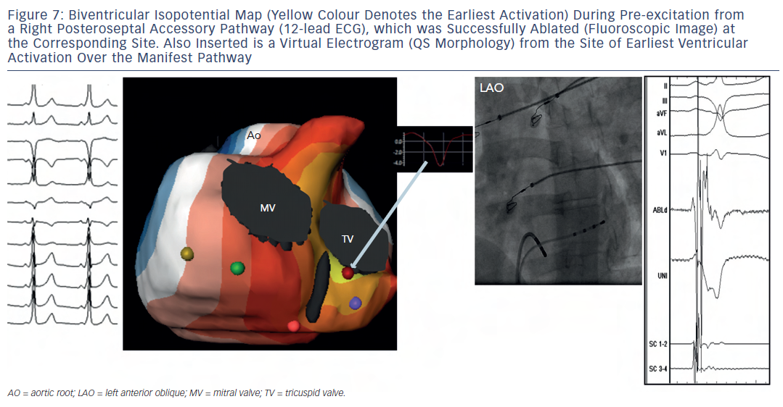
Shah AJ, Hocini M, Pascale P, Roten L, Komatsu Y, Daly M, Ramoul K, Denis A, Derval N, Sacher F, Dubois R, Bokan R, Eliatou S, Strom M, Ramanathan C, Jaïs P, Ritter P, Haissaguerre M
Figure 7: Biventricular Isopotential Map (Yellow Colour Denotes the Earliest Activation) During Pre-excitation froma Right Posteroseptal Accessory Pathway (12-lead ECG), which was Successfully Ablated (Fluoroscopic Image) atthe Corresponding Site. Also Inserted is a Virtual Electrogram (QS Morphology) from the Site of Earliest VentricularActivation Over the Manifest Pathway
Citation: Arrhythmia & Electrophysiology Review 2013;2(1):16-22
https://doi.org/10.15420/aer.2013.2.1.16

