Slide 1

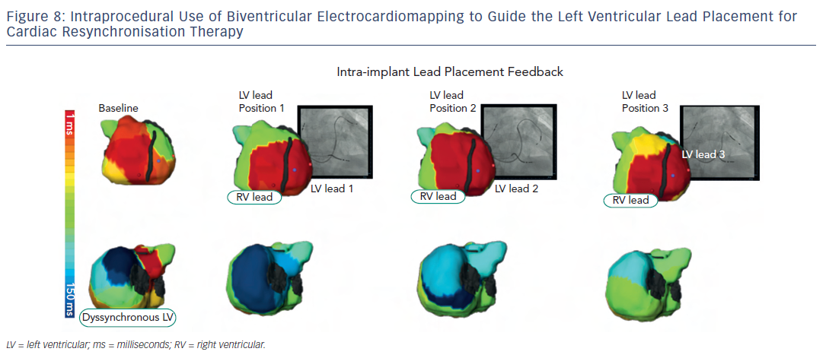
Shah AJ, Hocini M, Pascale P, Roten L, Komatsu Y, Daly M, Ramoul K, Denis A, Derval N, Sacher F, Dubois R, Bokan R, Eliatou S, Strom M, Ramanathan C, Jaïs P, Ritter P, Haissaguerre M
Figure 8: Intraprocedural Use of Biventricular Electrocardiomapping to Guide the Left Ventricular Lead Placement forCardiac Resynchronisation Therapy
Citation: Arrhythmia & Electrophysiology Review 2013;2(1):16-22
https://doi.org/10.15420/aer.2013.2.1.16

