Slide 1
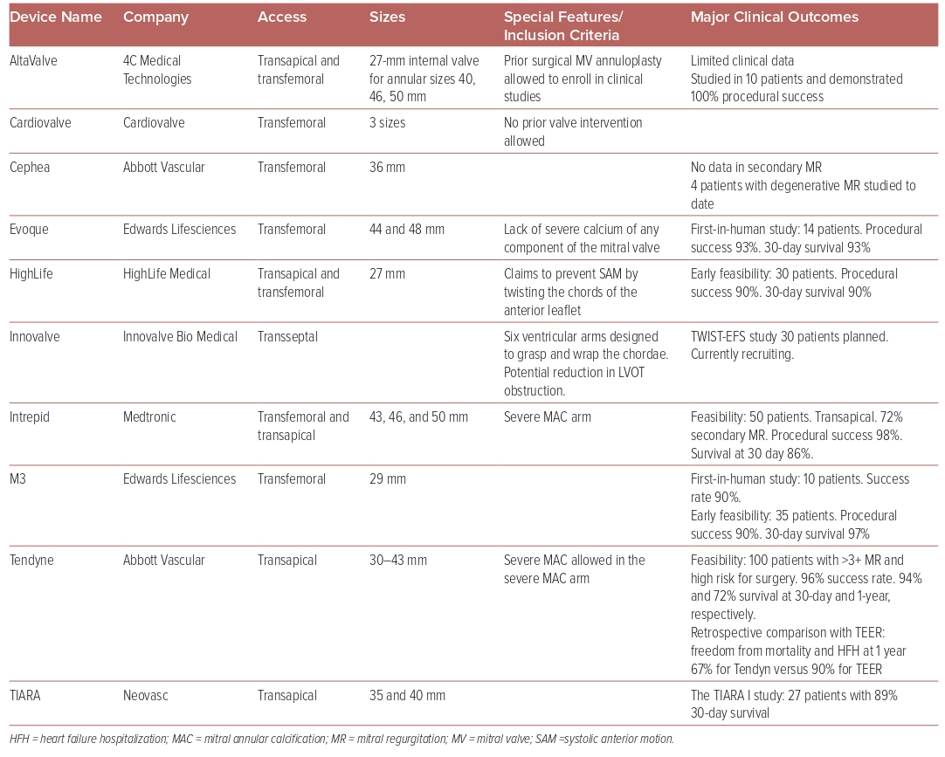
Dhaduk N, Chaus A, Williams D, Vainrib A, Ibrahim H
Table 2: Names, Characteristics, and Major Clinical Outcomes of Various Mitral Valve Replacement Systems
Citation: US Cardiology Review 2024;18:e05.
https://doi.org/10.15420/usc.2022.34

