Slide 1
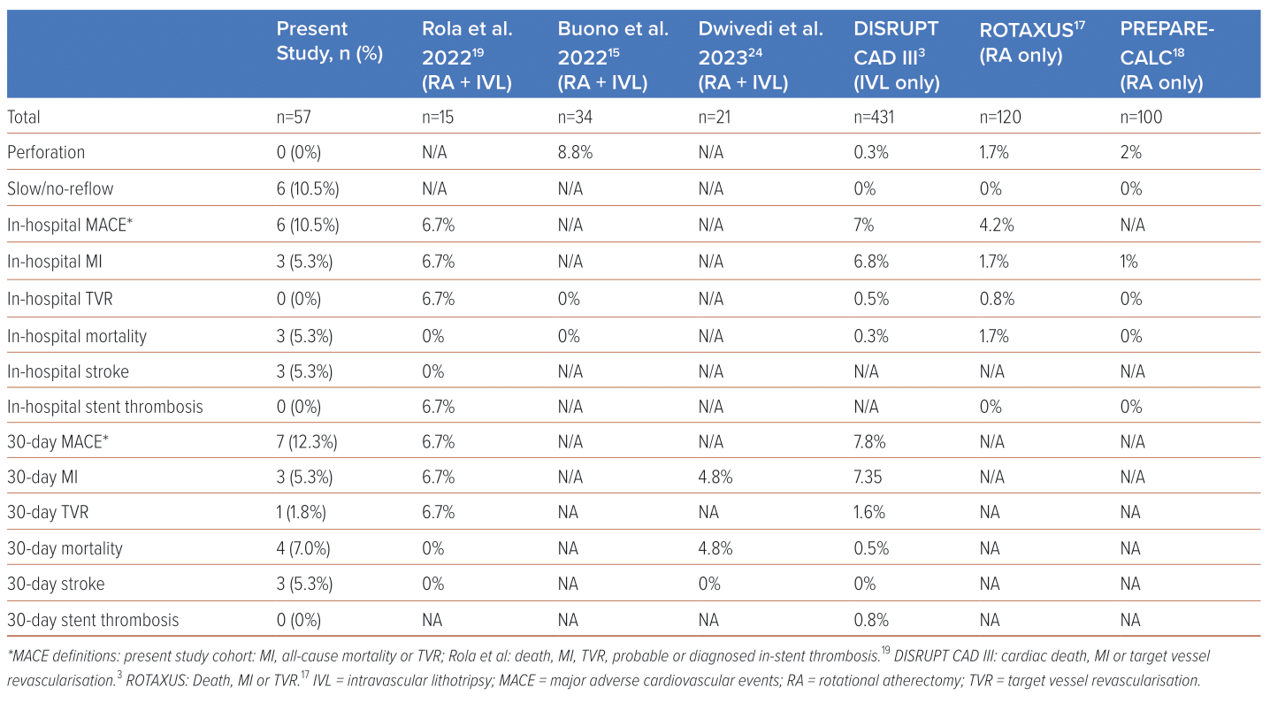
Wen Tern PJ, Keh YS, Lau YH, Wong JJ, Ho WHH, Jion MBI, Chin CY, Lim B, Ho KW, Liew BW, Tan JW, Koh TH, Yeo KK
Table 4: Outcomes
Citation: Journal of Asian Pacific Society of Cardiology 2024;3:e04.
https://doi.org/10.15420/japsc.2023.36

