Slide 1
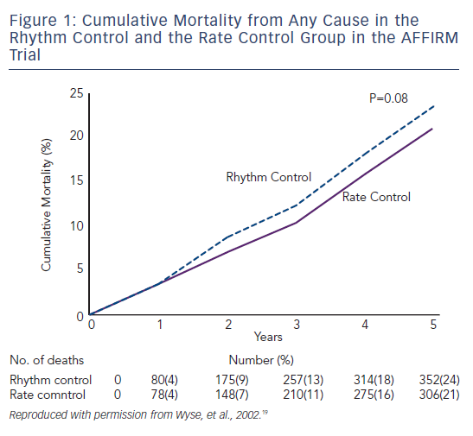
Maan A, Mansour M, Ruskin JN, Heist EK
Figure 1: Cumulative Mortality from Any Cause in the Rhythm Control and the Rate Control Group in the AFFIRM Trial
Citation: Arrhythmia & Electrophysiology Review 2013;2(1):30-5
https://doi.org/10.15420/aer.2013.2.1.30

