Slide 1
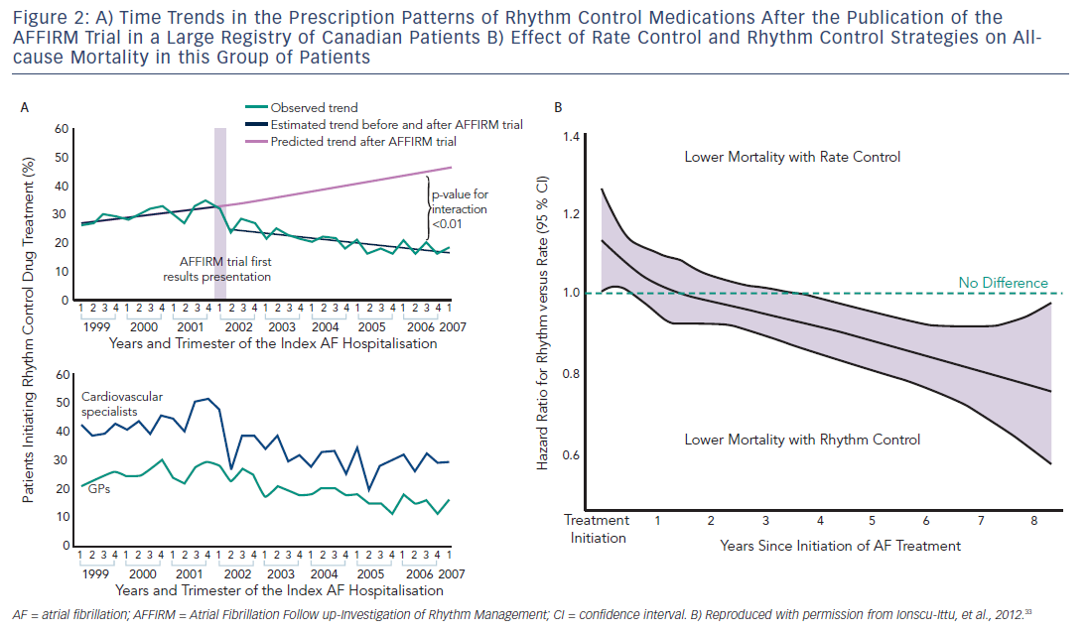
Maan A, Mansour M, Ruskin JN, Heist EK
Figure 2: A) Time Trends In The Prescription Patterns Of Rhythm Control B) Effect Of Rate Control And Rhythm Control Strategies
Citation: Arrhythmia & Electrophysiology Review 2013;2(1):30-5
https://doi.org/10.15420/aer.2013.2.1.30

