Slide 1
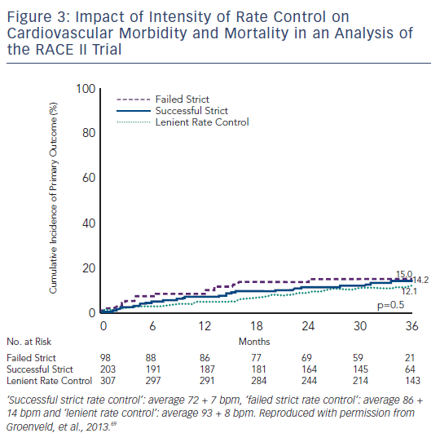
Maan A, Mansour M, Ruskin JN, Heist EK
Figure 3: Impact of Intensity of Rate Control on Cardiovascular Morbidity and Mortality in an Analysis of the RACE II Trial
Citation: Arrhythmia & Electrophysiology Review 2013;2(1):30-5
https://doi.org/10.15420/aer.2013.2.1.30

