Slide 1
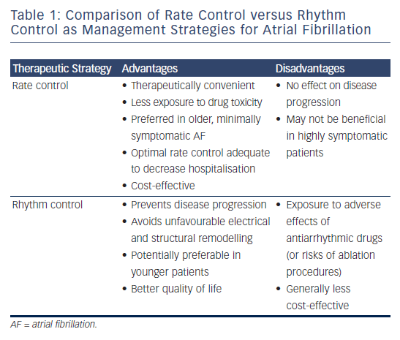
Maan A, Mansour M, Ruskin JN, Heist EK
Table 1: Comparison of Rate Control versus Rhythm Control as Management Strategies for Atrial Fibrillation
Citation: Arrhythmia & Electrophysiology Review 2013;2(1):30-5
https://doi.org/10.15420/aer.2013.2.1.30

