Slide 1
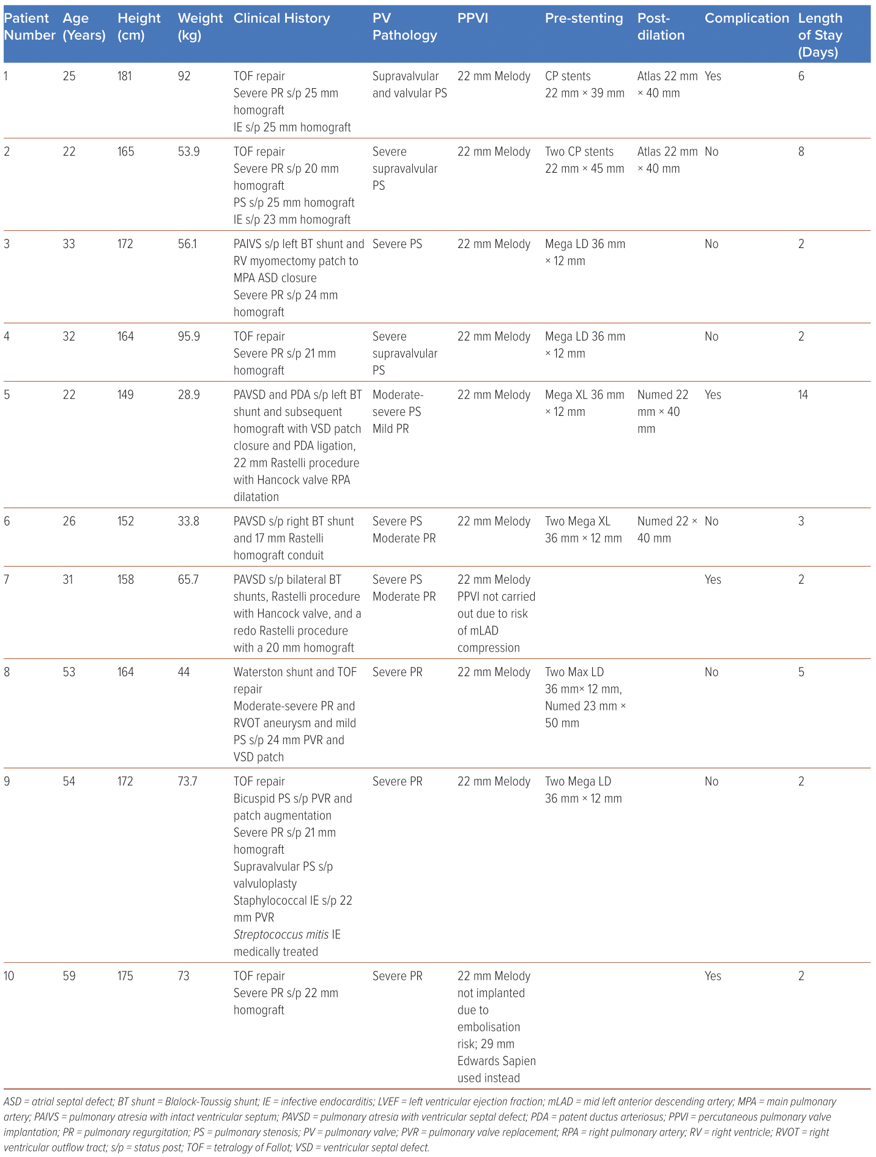
Lim FY, Foo JS, Yap JJL, Teck Lee P, Sundararaghavan S, Le Tan J
Table 1: Clinical Characteristics of Study Population
Citation: Journal of Asian Pacific Society of Cardiology 2024;4:e06.
https://doi.org/10.15420/japsc.2023.79

