Slide 1
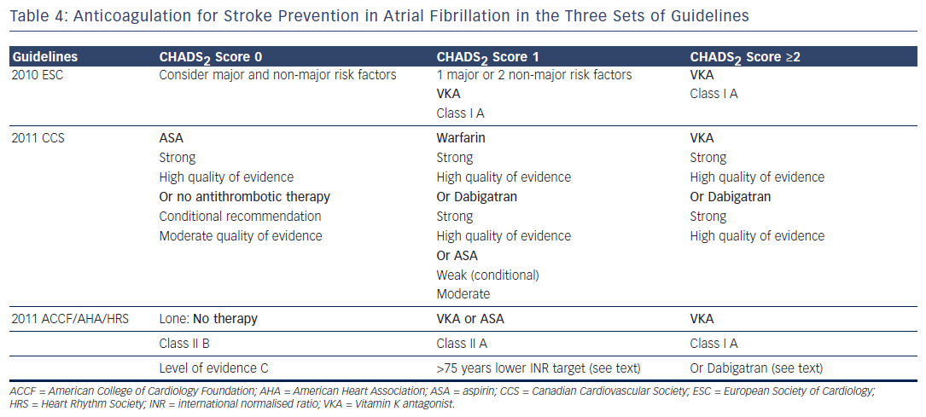
Lévy S
Table 4: Anticoagulation for Stroke Prevention in Atrial Fibrillation in the Three Sets of Guidelines
Citation: Arrhythmia & Electrophysiology Review 2013;2(1):8-15
https://doi.org/10.15420/aer.2013.2.1.8

