Slide 1
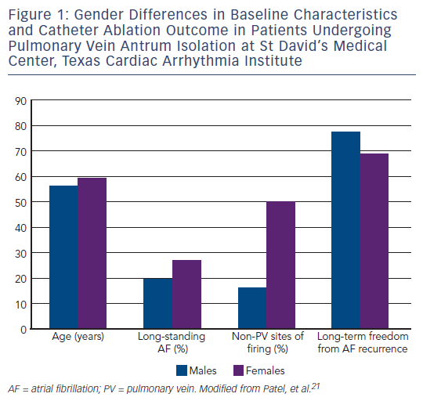
Santangeli P, Di Biase L, Basile E, Al-Ahmad A, Natale A
Figure 1: Gender Differences in Baseline Characteristics and Catheter Ablation Outcome in Patients Undergoing Pulmonary Vein Antrum Isolation at St David’s Medical Center, Texas Cardiac Arrhythmia Institute
Citation: Arrhythmia & Electrophysiology Review 2013;2(1):41-4
https://doi.org/10.15420/aer.2013.2.1.41

