Slide 1
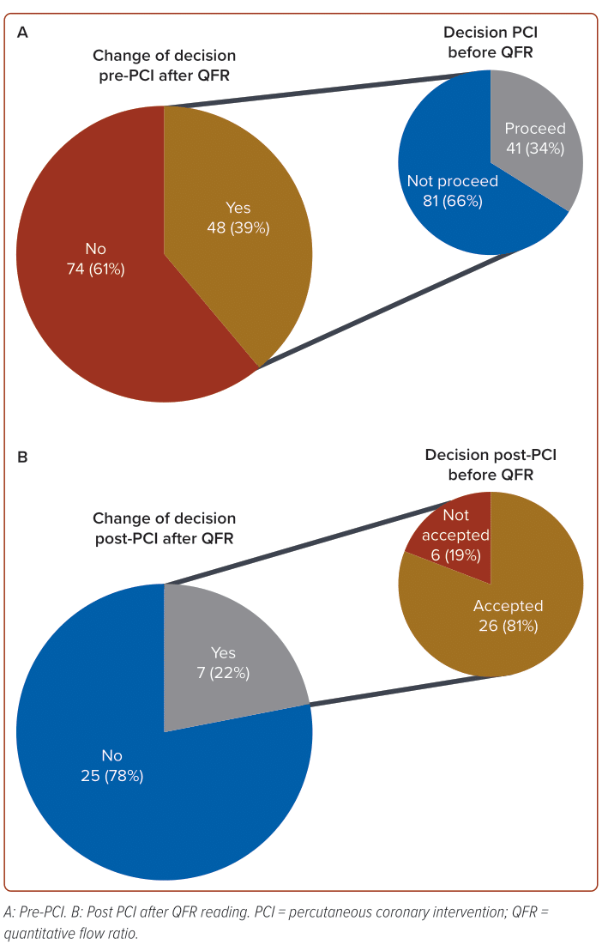
Sukahri S, Zuhdi ASM, Chee KH, Abidin IZ, Singh RSA, Loch A, Sari NAM, Anuar NK, Lee KW, Aseri MA, Isa MR, Ahmad WAW
Figure 3: Change of Decision
Citation: Journal of Asian Pacific Society of Cardiology 2024;3:e08.
https://doi.org/10.15420/japsc.2023.72

