Slide 1
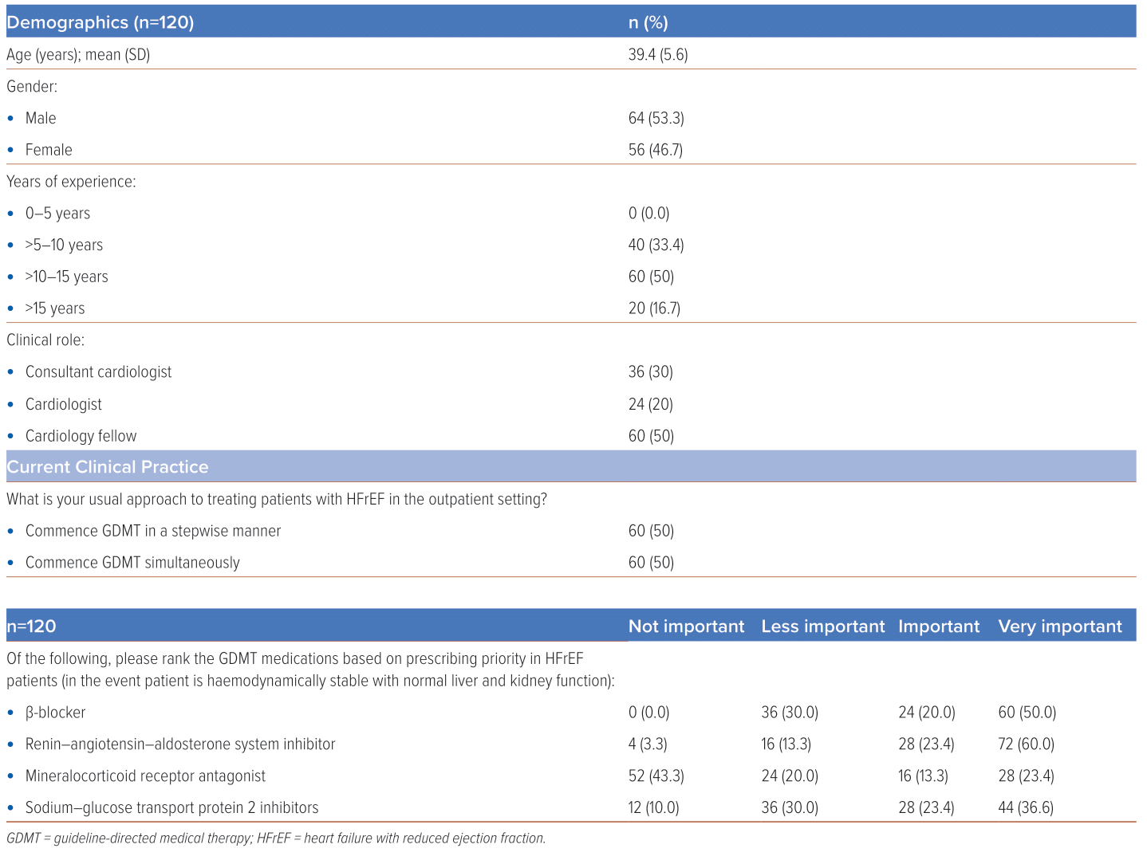
Shariff RER, Ibrahim KS, Kasim SS
Table 1: Demographics of Respondents and Current Clinical Practice in Prescribing Guideline-directed Medical Therapy
Citation: Journal of Asian Pacific Society of Cardiology 2024;3:e07.
https://doi.org/10.15420/japsc.2023.64

