Slide 1
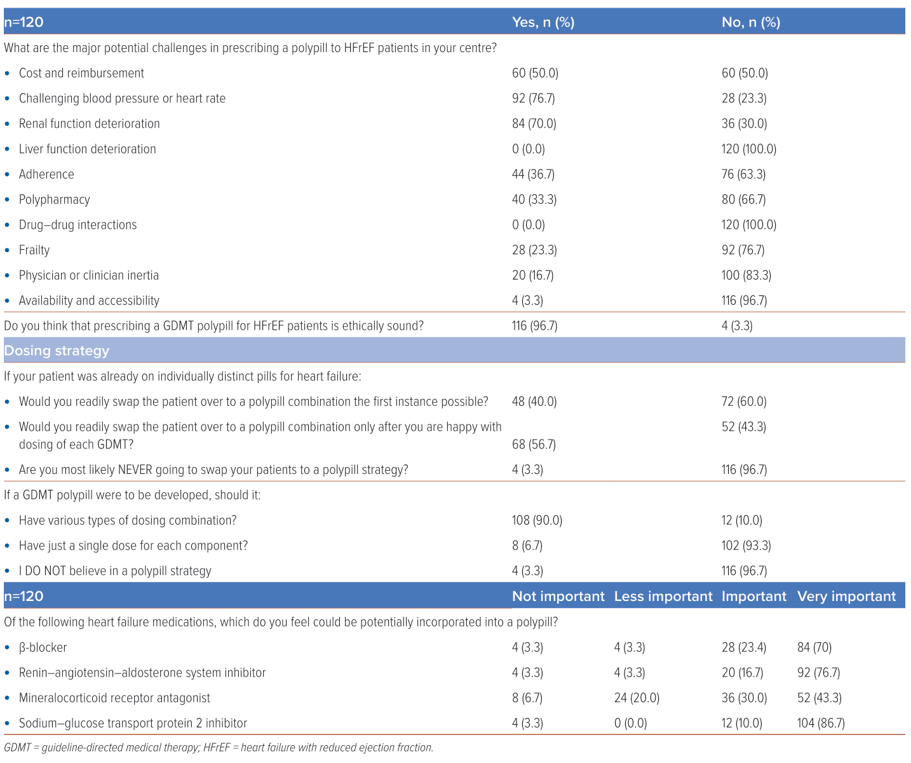
Shariff RER, Ibrahim KS, Kasim SS
Table 2: Knowledge, Attitudes and Perception Surrounding Prescription of a Polypill in Managing Heart Failure
Citation: Journal of Asian Pacific Society of Cardiology 2024;3:e07.
https://doi.org/10.15420/japsc.2023.64

