Slide 1
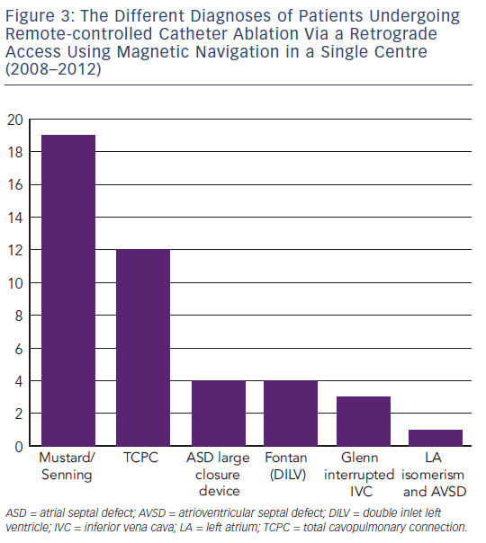
Suman-Horduna I, Babu-Narayan S, Ernst S
Remote Controlled Catheter Ablation Via a Retrograde Access
Citation: Arrhythmia & Electrophysiology Review 2013;2(1):53-8
https://doi.org/10.15420/aer.2013.2.1.53

