Slide 1
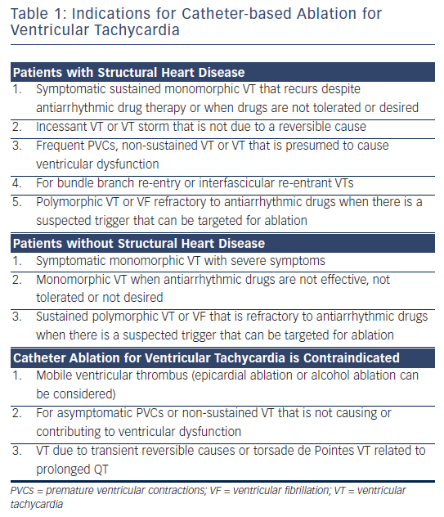
Nof E, Stevenson WG, John R
Table 1: Indications for Catheter-based Ablation for Ventricular Tachycardia
Citation: Arrhythmia & Electrophysiology Review 2013;2(1):45-52
https://doi.org/10.15420/aer.2013.2.1.45

