Slide 1
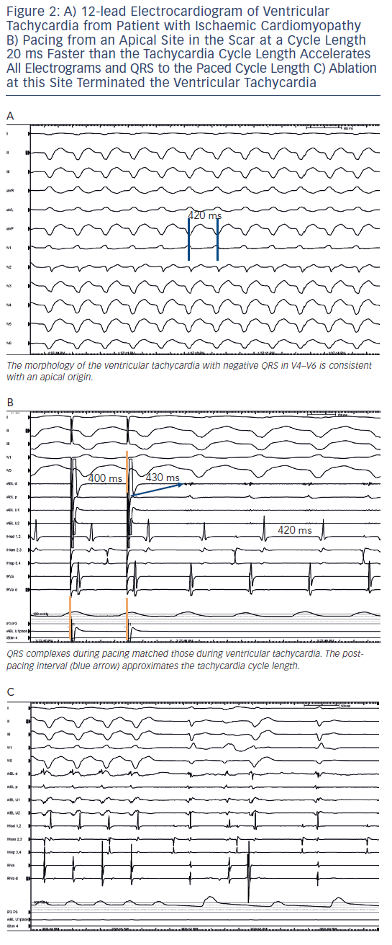
Nof E, Stevenson WG, John R
Figure 2: 12-lead Electrocardiogram of Ventricular
Citation: Arrhythmia & Electrophysiology Review 2013;2(1):45-52
https://doi.org/10.15420/aer.2013.2.1.45

