Slide 1
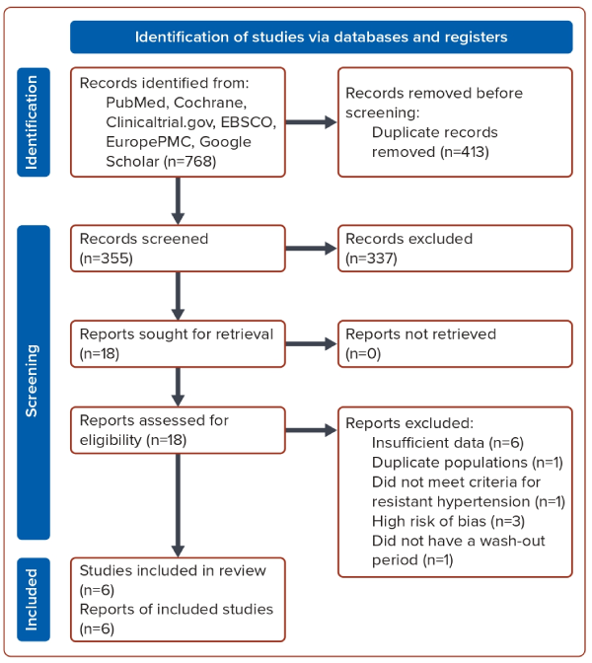
Lim H, Hamdani WN
Figure 1: Study Flow Diagram
Citation: Journal of Asian Pacific Society of Cardiology 2024;3:e12.
https://doi.org/10.15420/japsc.2023.45

