Slide 1

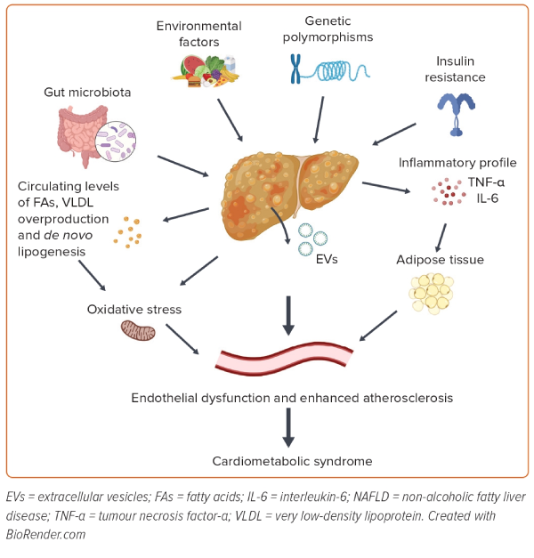
Gato S, García-Fernández V, Gil-Gómez A, Rojas �, Montero-Vallejo R, Muñoz-Hernández R, Romero-Gómez M
Figure 1: Mechanisms Potentially Responsible for Endothelial Dysfunction and Atherosclerosis in Non-alcoholic Fatty Liver Disease
Citation: European Cardiology Review 2024;19:e03.
https://doi.org/10.15420/ecr.2023.26

