Slide 1

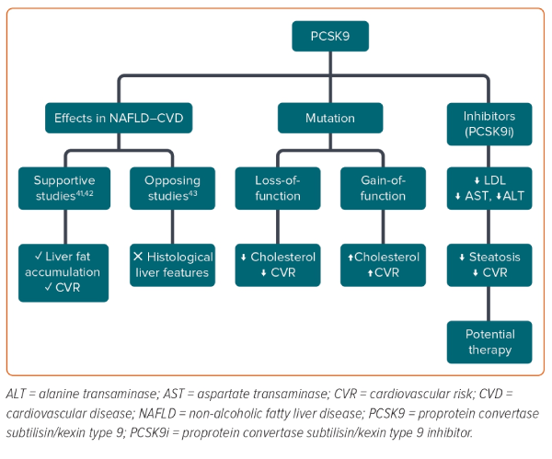
Gato S, García-Fernández V, Gil-Gómez A, Rojas �, Montero-Vallejo R, Muñoz-Hernández R, Romero-Gómez M
Figure 2: Possible Effects of Proprotein Convertase Subtilisin/Kexin Type 9 on Non-alcoholic Fatty Liver Disease and Related Cardiovascular Disease
Citation: European Cardiology Review 2024;19:e03.
https://doi.org/10.15420/ecr.2023.26

