Slide 1
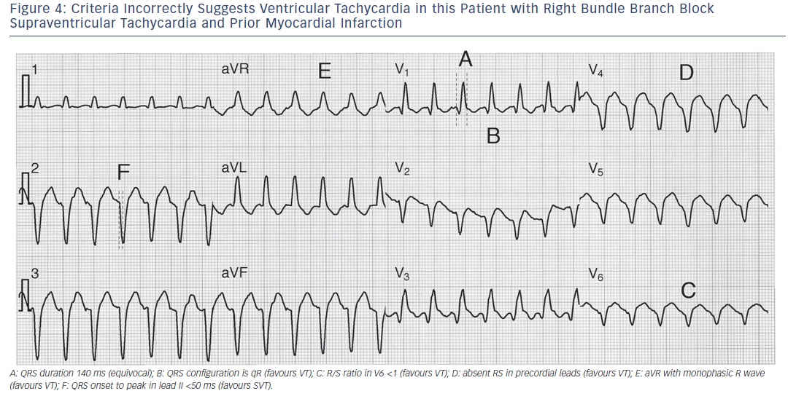
Garner JB, Miller JM
Figure 4: Criteria Incorrectly Suggests Ventricular Tachycardia in this Patient with Right Bundle Branch Block Supraventricular Tachycardia and Prior Myocardial Infarction
Citation: Arrhythmia & Electrophysiology Review 2013;2(1):23-9
https://doi.org/10.15420/aer.2013.2.1.23

