Slide 1
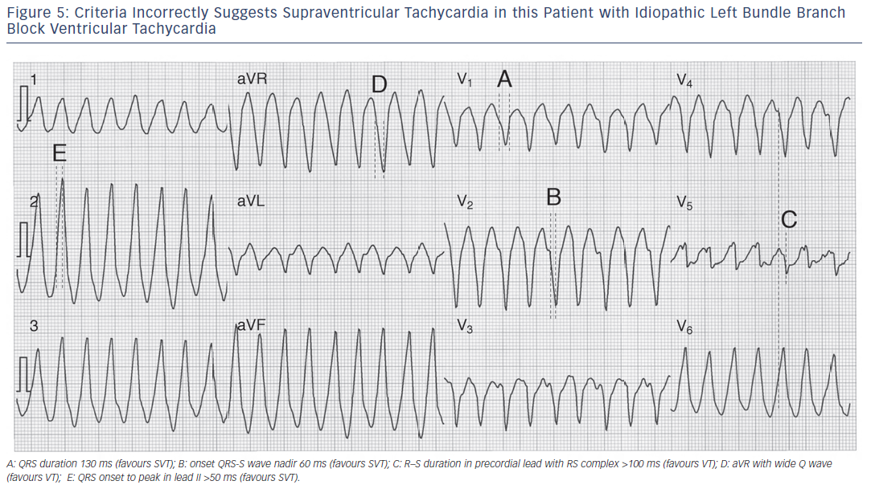
Garner JB, Miller JM
Figure 5: Criteria Incorrectly Suggests Supraventricular Tachycardia in this Patient with Idiopathic Left Bundle Branch Block Ventricular Tachycardia
Citation: Arrhythmia & Electrophysiology Review 2013;2(1):23-9
https://doi.org/10.15420/aer.2013.2.1.23

