Slide 1
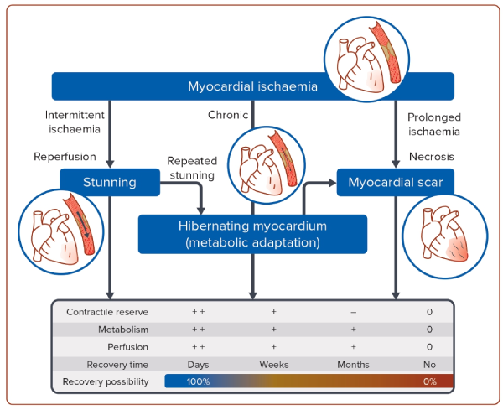
Haring B, Böhm M
Figure 1: Myocardial Stunning, Hibernating Myocardium and Myocardial Scar
Citation: Journal of Asian Pacific Society of Cardiology 2024;3:e14
https://doi.org/10.15420/japsc.2024.05

