Slide 1
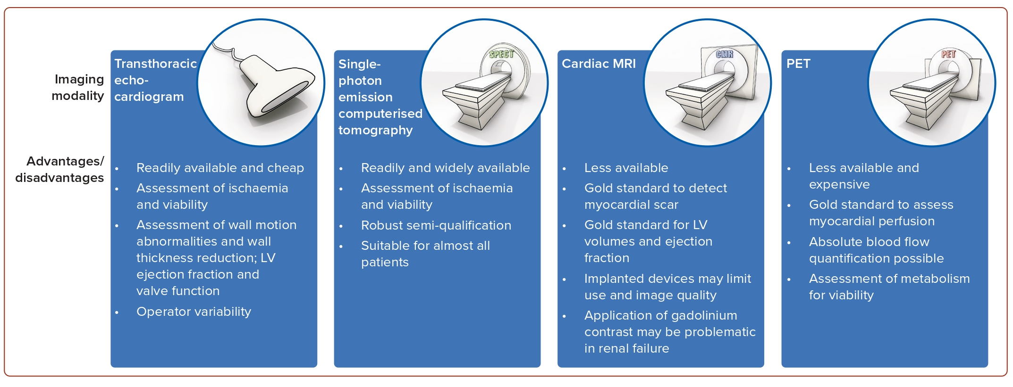
Haring B, Böhm M
Figure 2: Imaging Modalities to Assess Myocardial Ischaemia and Viability
Citation: Journal of Asian Pacific Society of Cardiology 2024;3:e14
https://doi.org/10.15420/japsc.2024.05

