Slide 1
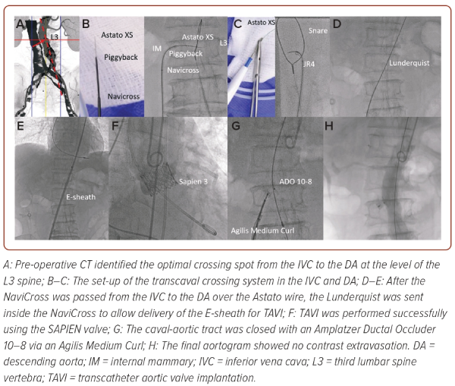
So Cy, Lai LKL, Wong LN, Ka-Lung C, Kam KKh, Chan AK, Lee A, Wu EB, Wong RH, Chan YS
Figure 1: Procedural Highlights of Transcaval Transcatheter Aortic Valve Implantation
Citation: Journal of Asian Pacific Society of Cardiology 2024;3:e15.
https://doi.org/10.15420/japsc.2024.03

