Slide 1
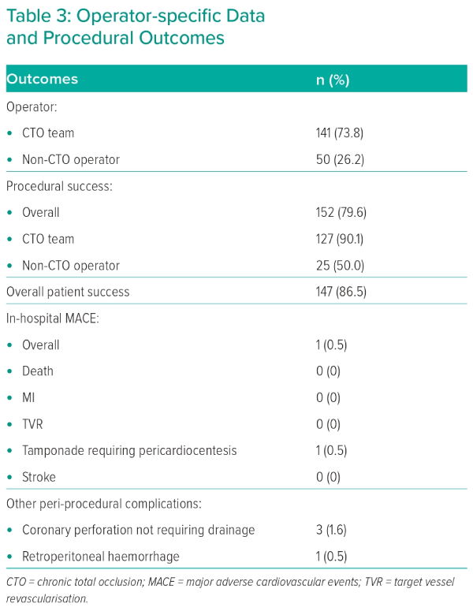
Gilpin TR, Maznyczka A, Anantharam B, Dana A
Operator-specific Data and Procedural Outcomes
Citation: Interventional Cardiology 2024;19:e05.
https://doi.org/10.15420/icr.2023.23

