Slide 1
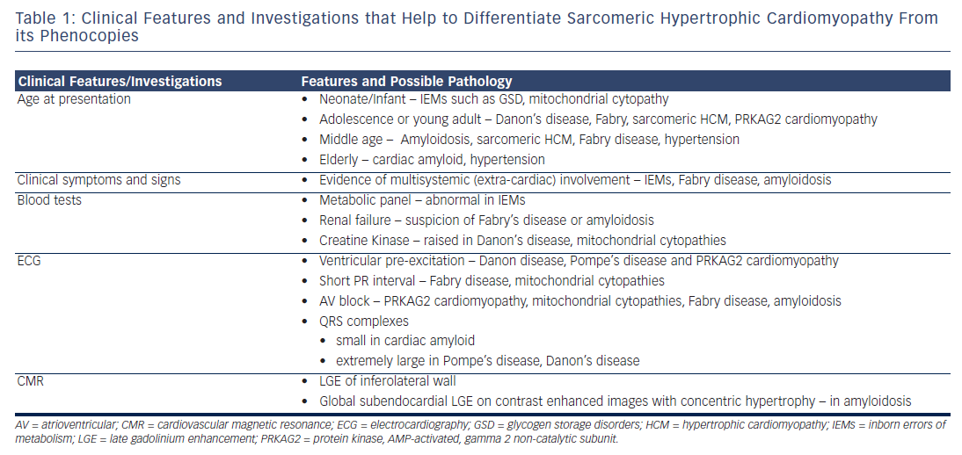
Sankaranarayanan R, Fleming EJ, Garratt CJ
Table 1: Clinical Features and Investigations that Help to Differentiate Sarcomeric Hypertrophic Cardiomyopathy From its Phenocopies
Citation: Arrhythmia & Electrophysiology Review 2013;2(1):36-40
https://doi.org/10.15420/aer.2013.2.1.36

